Slide 1
Analysis on Genre
Preferences by Age
Alona Reji

Slide 2
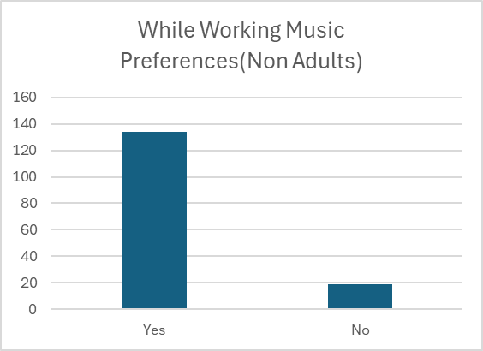
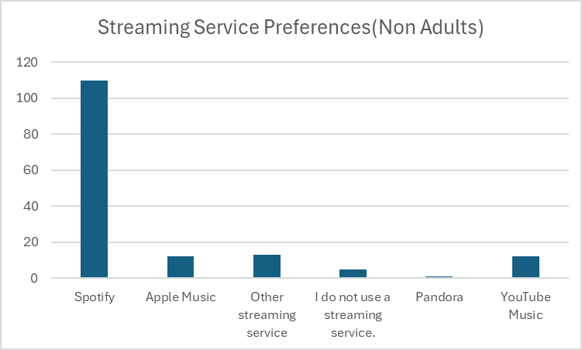
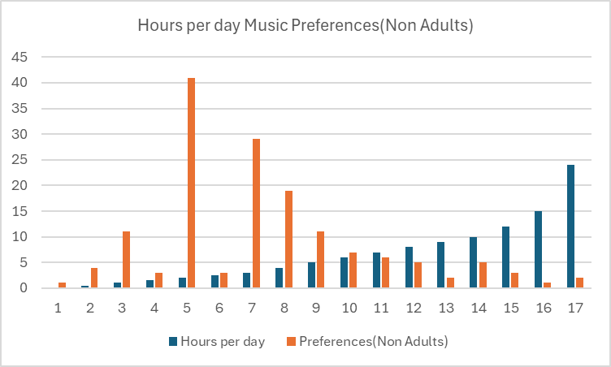
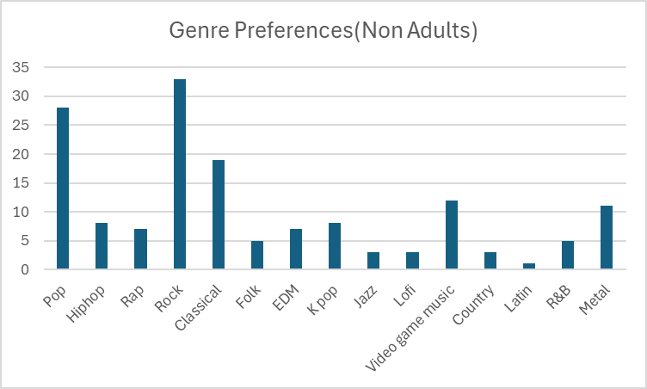
Non Adults
Most streamed platform:Spotify
Least streamed platform:Pandora
Mostly preferred while working:Yes
Most hrs spend:2hrs
Most preffered genre:Rock
Least preffered genre:Latin
(Gospel-none)

Slide 3
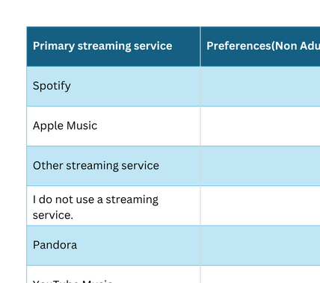
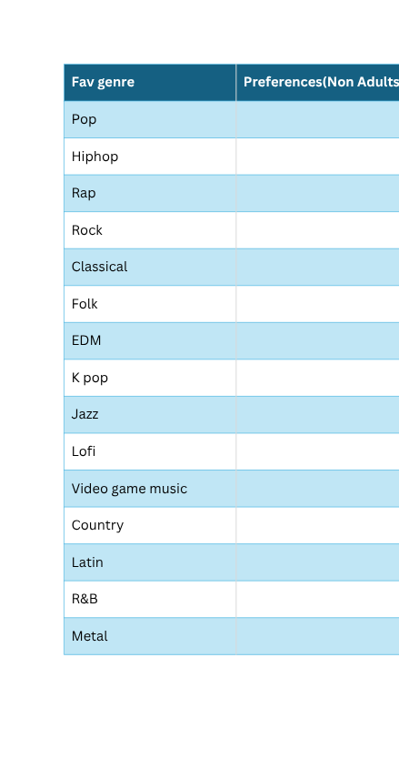
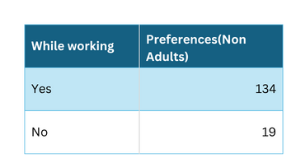
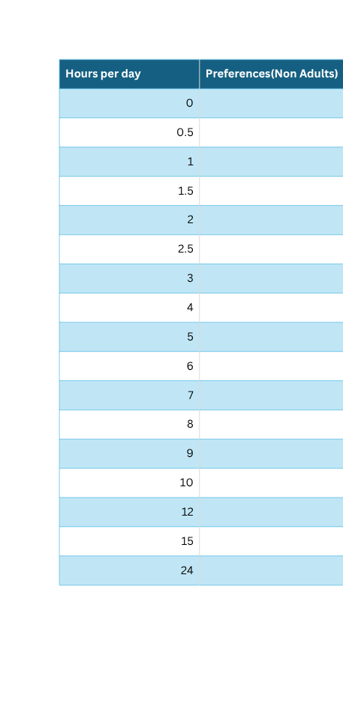
Overview

Slide 4
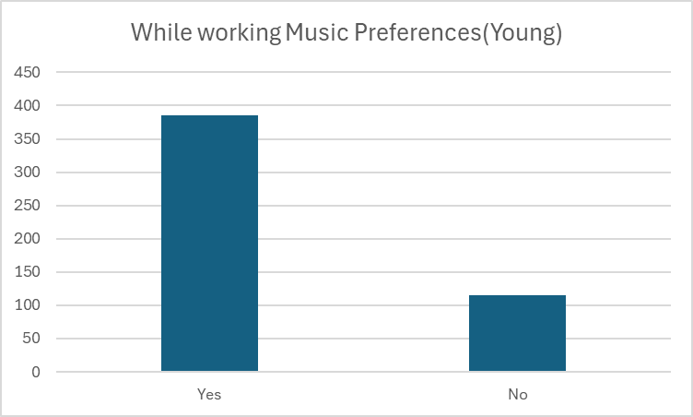
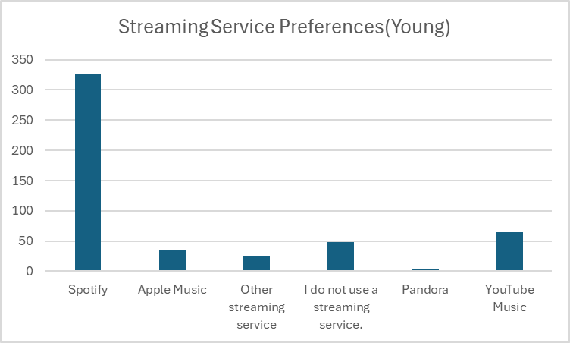
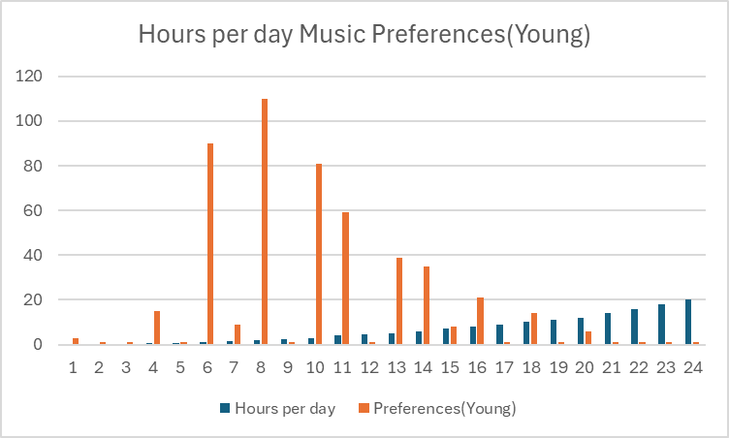
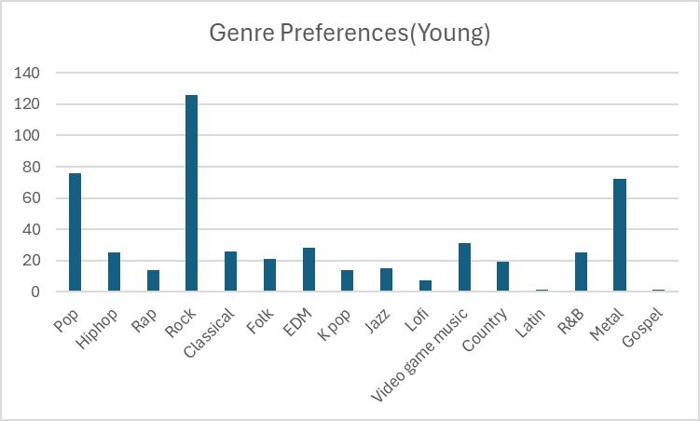
Young
Most streamed platform:Spotify
Least streamed platform:Pandora
Mostly preferred while working:Yes
Most hrs spend:2hrs
Most preffered genre:Rock
Least preffered genre:Latin and Gospel

Slide 5
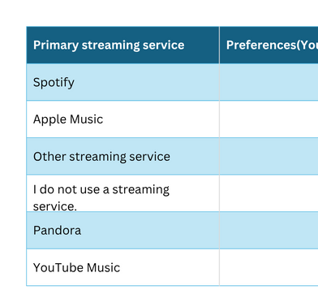
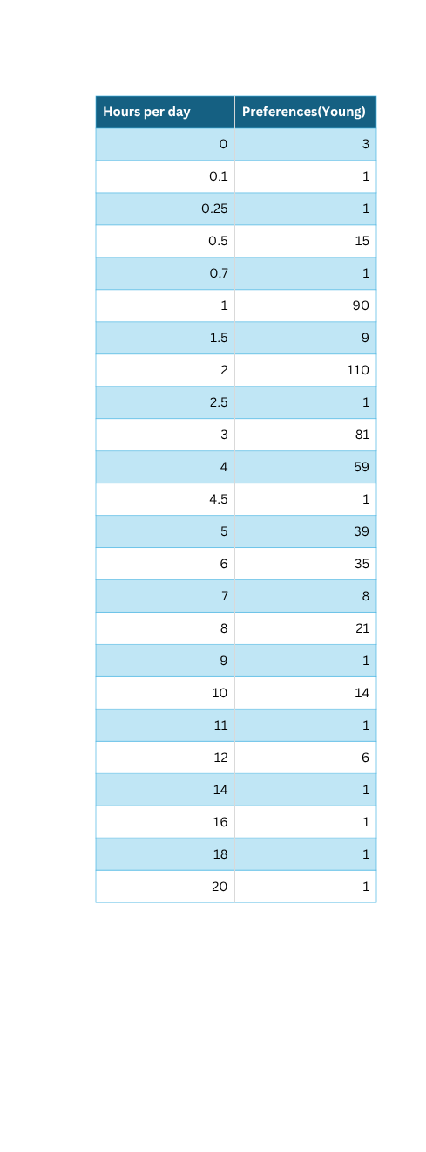
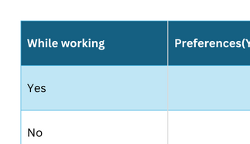
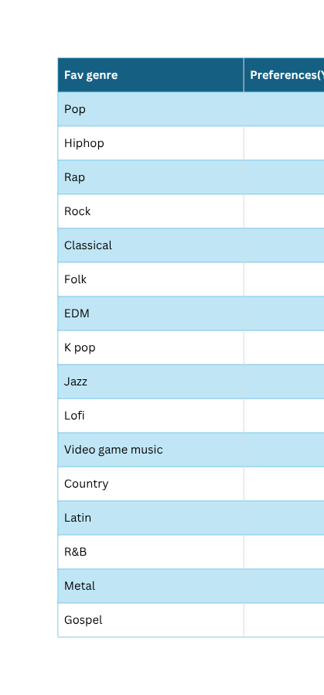

Slide 6
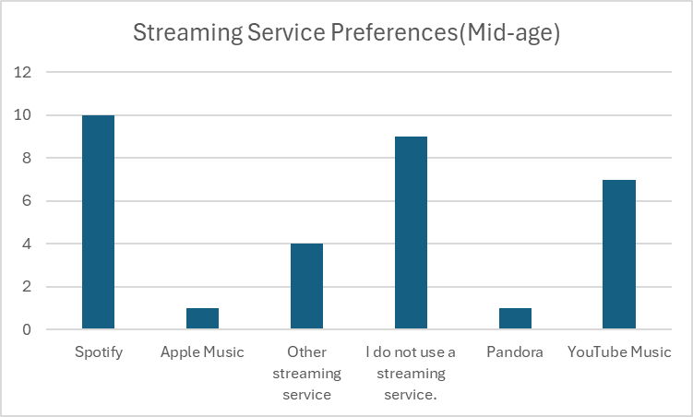
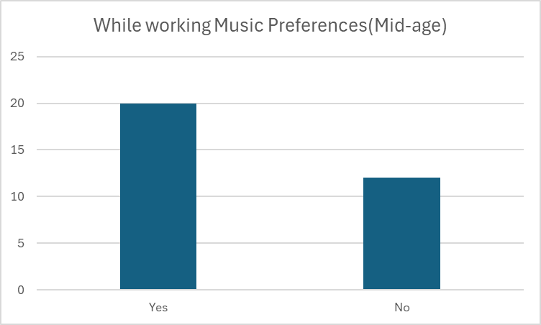
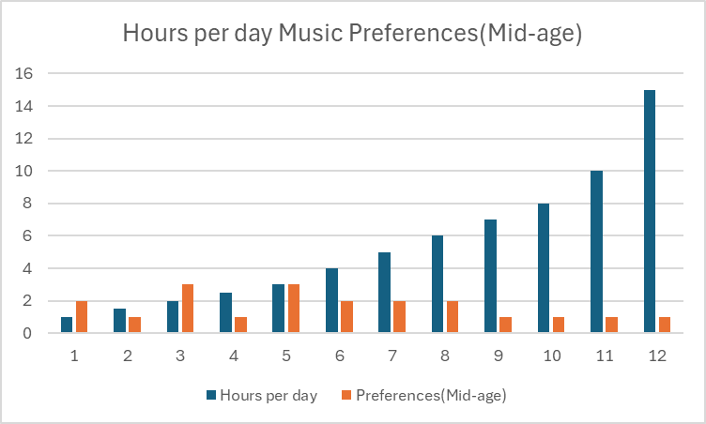
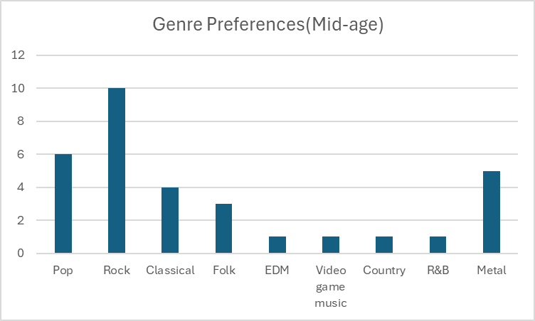
Mid-age
Most streamed platform:Spotify
Least streamed platform:Apple Music and Pandora
Mostly preferred while working:Yes
Most hrs spend:2 hrs and 3 hrs
Most preffered genre:Rock
Least preffered genre:EDM,Video game music,Country,R&B
(hiphop,rap,kpop,jazz,lofi,latin,gospel-none)

Slide 7
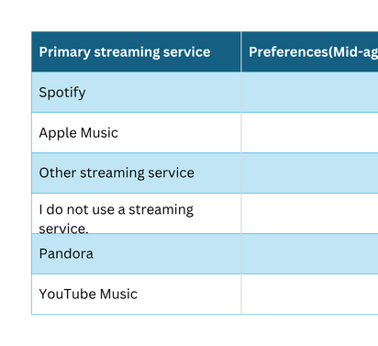
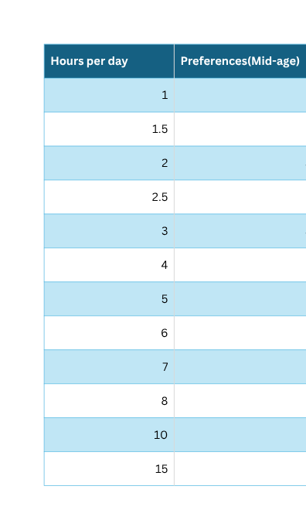
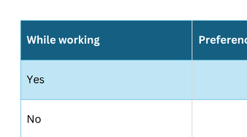
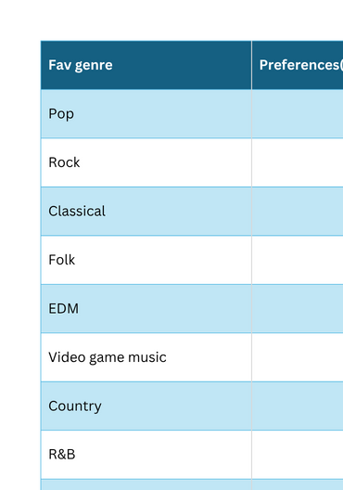

Slide 8
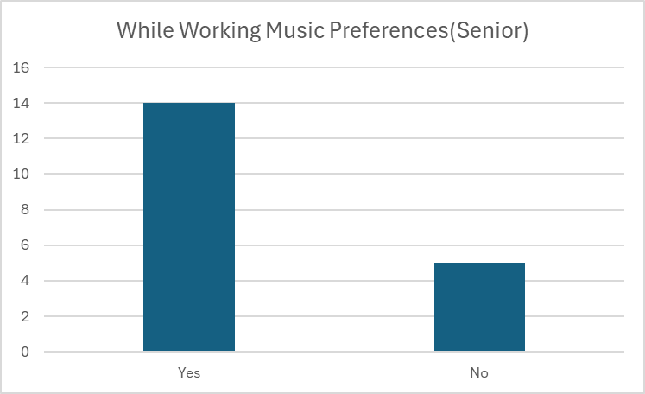
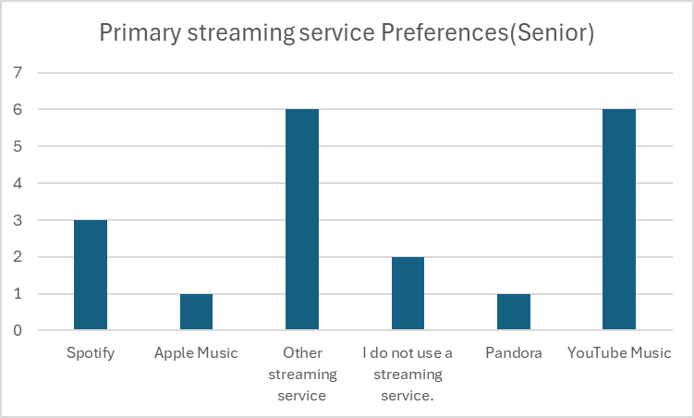
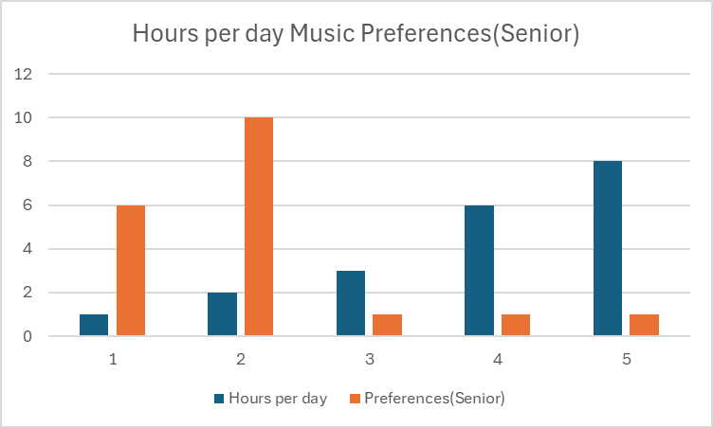
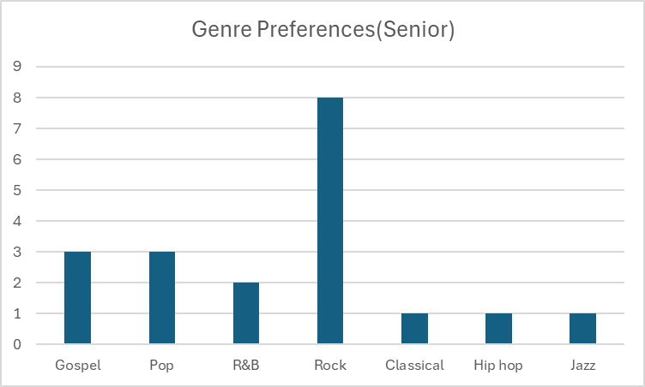
Senior
Most streamed platform:Youtube Music and other streaming service
Least streamed platform:Pandora and Apple Music
Mostly preferred while working:Yes
Most hrs spend:2hrs
Most preffered genre:Rock
Least preffered genre:Classical,Hiphop,Jazz
(EDM,Video game music,Country,
Rap,Kpop,Lofi,Latin,Folk,Metal-none)

Slide 9
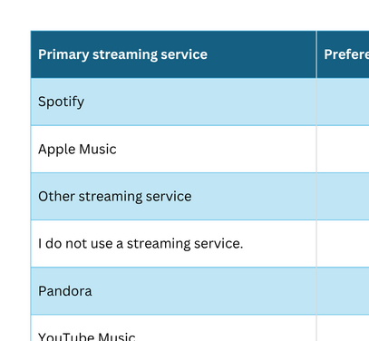
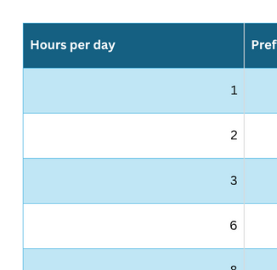
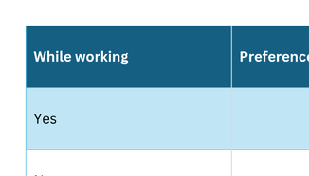
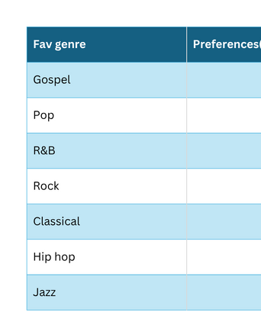

Slide 10
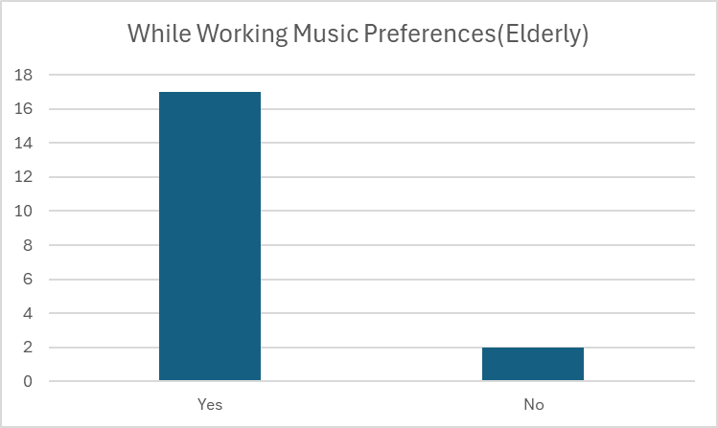
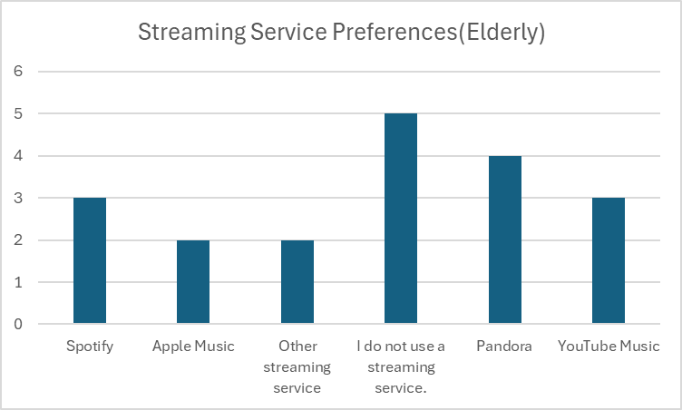
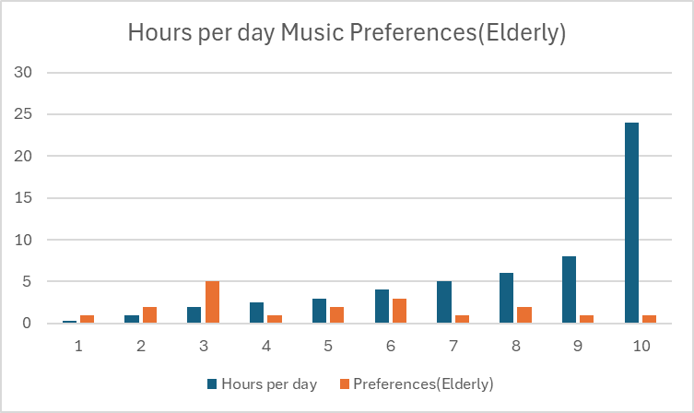
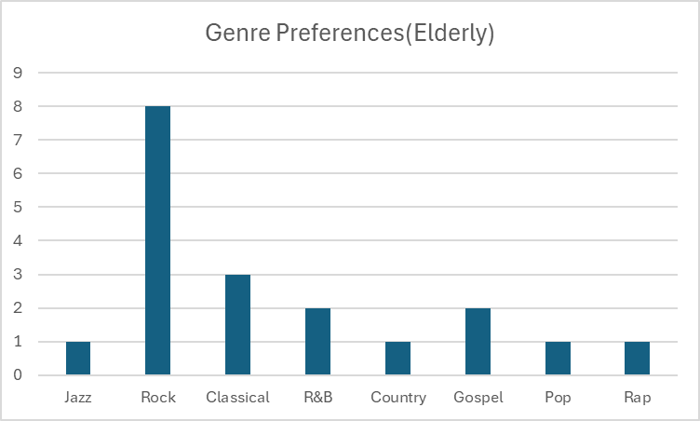
Elderly
Most streamed platform:Doesnt use streaming service
Least streamed platform:Other streaming service
Mostly preferred while working:Yes
Most hrs spend:2hrs
Most preffered genre:Rock
Least preffered genre:Jazz,Country,Pop,Rap
(EDM,Video game music,Kpop,Lofi,Latin,Folk,Metal-none)

Slide 11
